Slide 1

Using RStudio and GitHub for Reproducible Science

Slide 2
AGENDA
Importance of Reproducible Science
Project Organization
Rprojects and GitHub
Connecting to GitHub

Slide 3
All the slides and additional resources available
https://github.com/kpgund/github_workshop

Slide 4
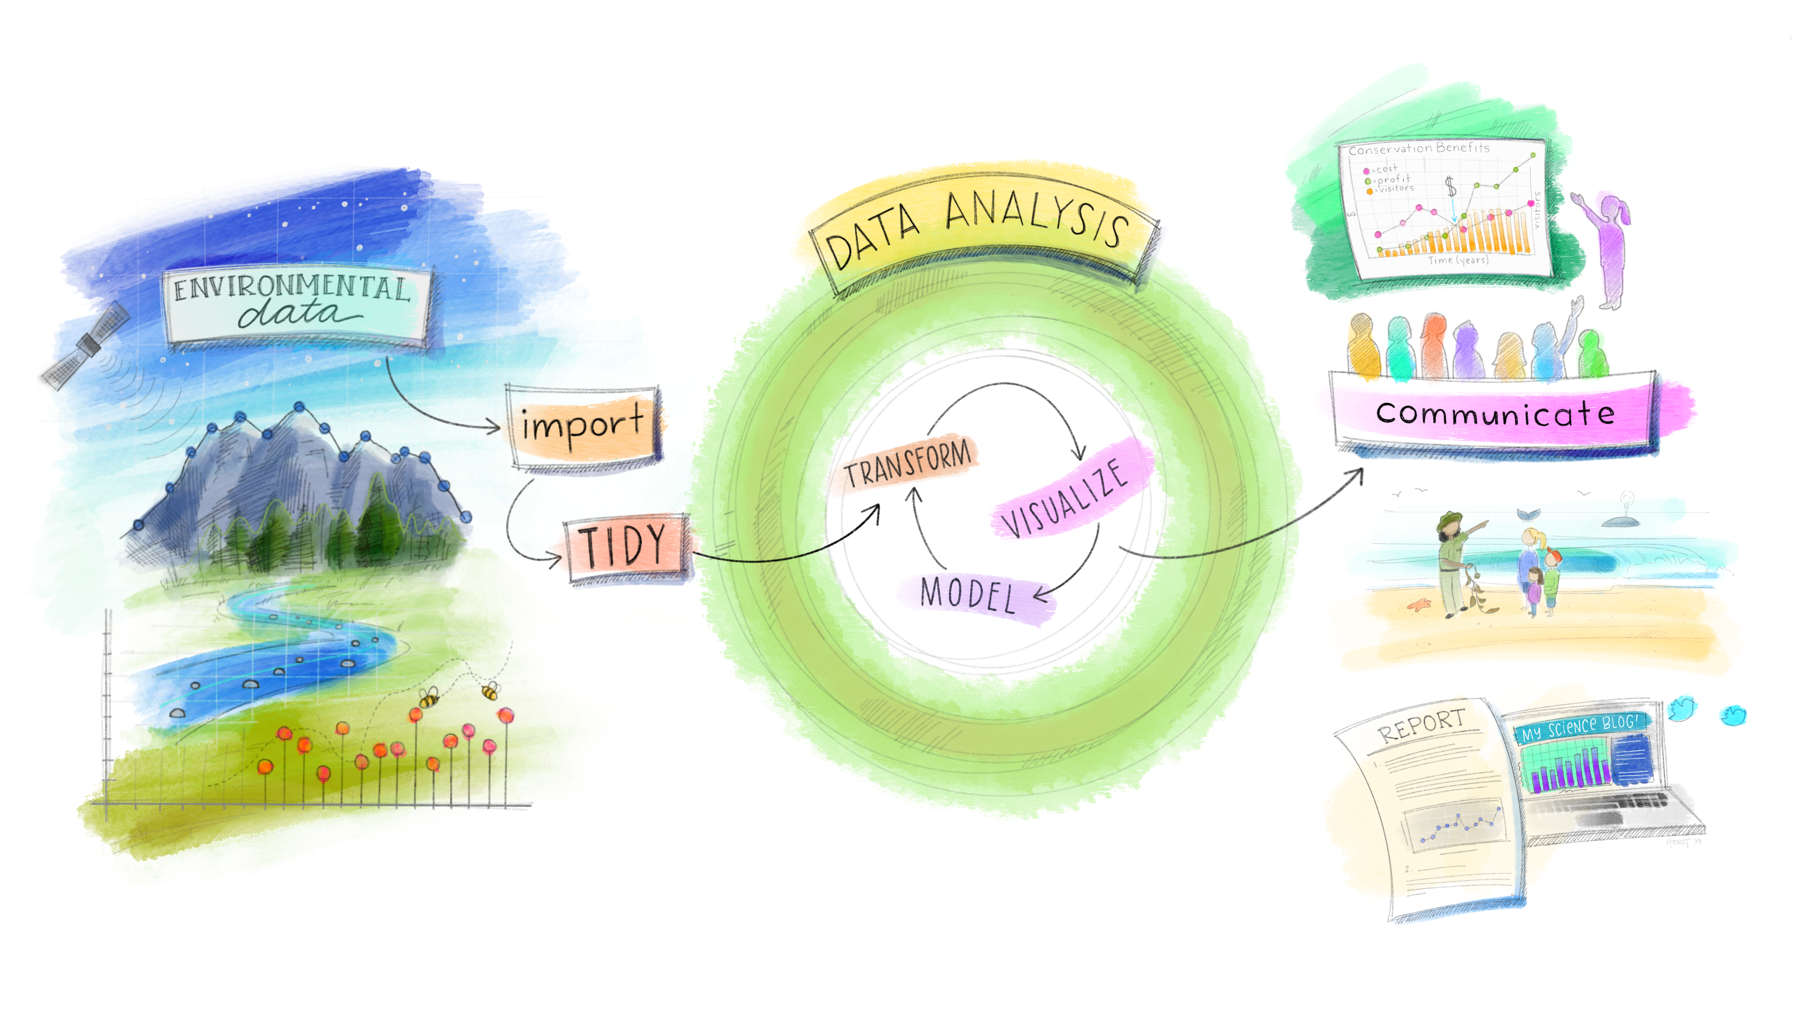
Importance of Reproducible Science
“Reproducibility is a pillar of the scientific method” – Dr. Picardi
Being proficient in the use of programming tools and effectively apply them to store, process, manage, analyze, and visualize data have become must-have skills to take part in the scientific discourse.
Artwork by Allison Horst

Slide 5
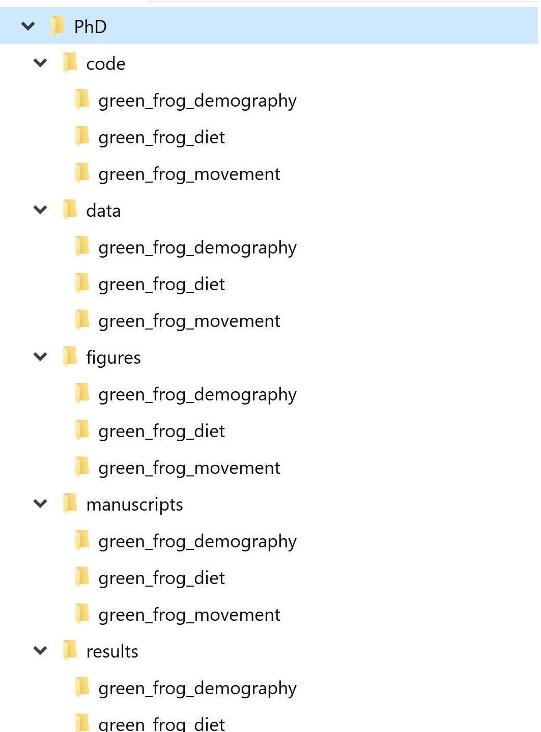
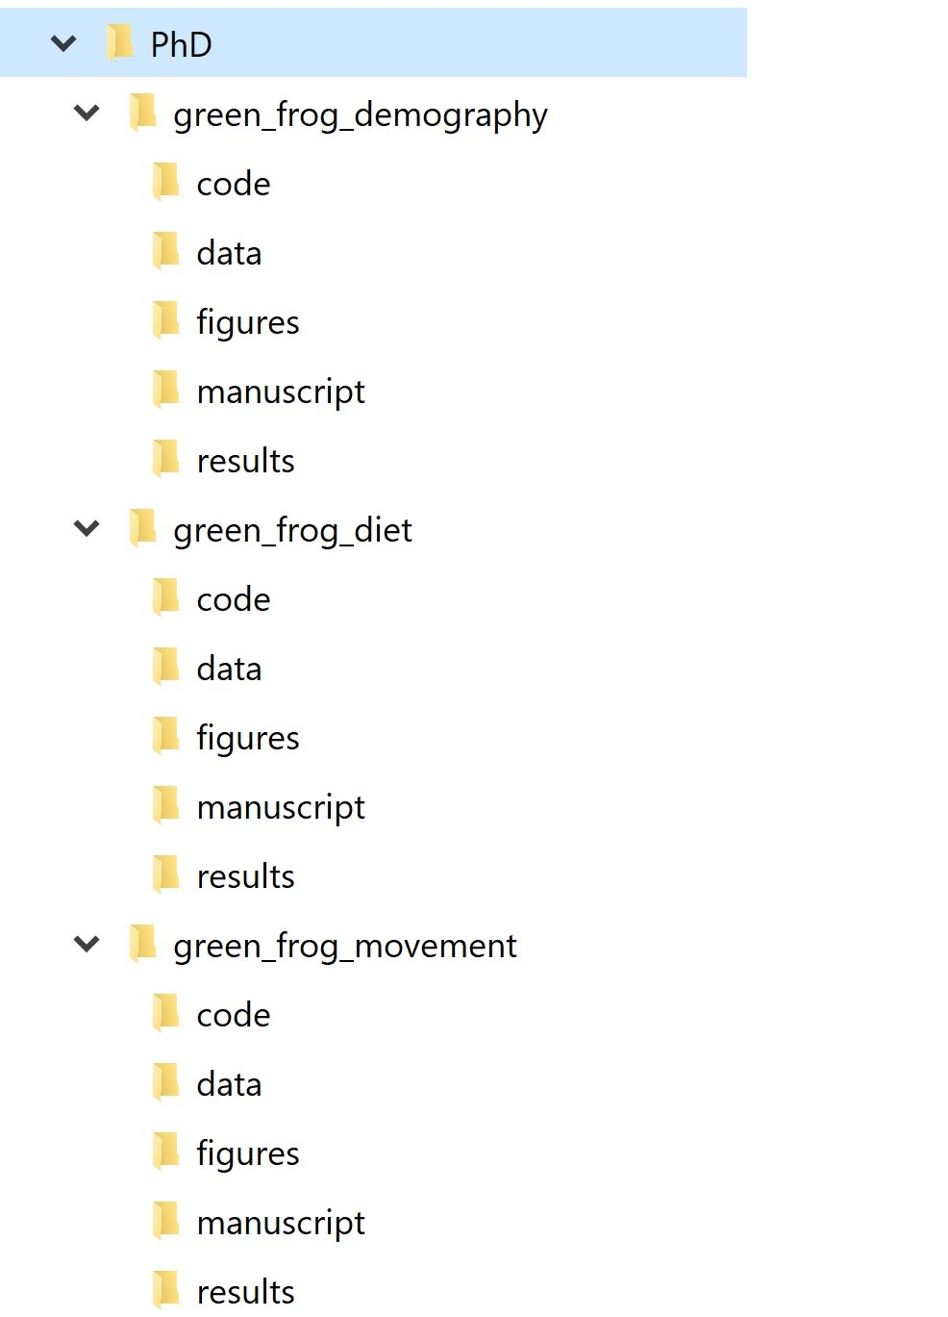
Project Organization
Everything meaningful in one folder structure
Folder Structure
Project-based
Activity-based
File Naming

Slide 6
File Naming
Ex: What we don’t want:
data.csv data_cleaned_March-22-2012.csv analysis code.R Green Frogs Manuscript_Final_edits.docx final.docx
Ex: What we do want:
20221009_GitHub-workshop_powerpoint.ppt
01_DataOrganization.R
02_DataCleaning.R
03_Analysis.R
Good file names are computer-readable, human-readable, and work well with default ordering.

Slide 7
Golden rules
Raw data should never be changed. Save it into a “data” folder and treat it as immutable. You can even set it as read-only to make sure there is no room for accidents.
The processed, clean version of your data will go into a dedicated “processed_data” folder.
Anything that can be generated from code goes into its own folder. This includes basically everything but the raw data and the code itself. You can have an “output” folder, or separate folders for output files and figures (e.g., “output” and “figures”)
If there are text documents, put them in their own folder (e.g., “docs”)
Code also has its own folder. If you write a lot of functions, it can be helpful to have a “funs” folder to store those and a “src” (for ‘source’) folder to save processing/analysis code.
If processing/analysis scripts are meant to be used in a certain order, you can number them (more on this in a minute). Sometimes the pipeline is not linear but branched, so numbering may not always make sense. Function scripts should not be numbered.
Modularize your code: instead of having a giant script to run your entire analysis from data cleaning to final figures, break up your workflow into several short, single-purpose scripts with well-defined inputs and outputs.

Slide 8
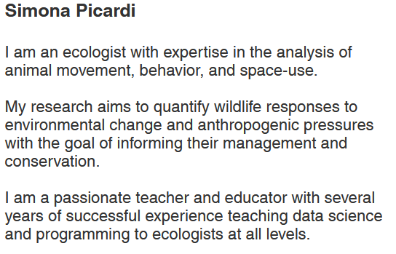
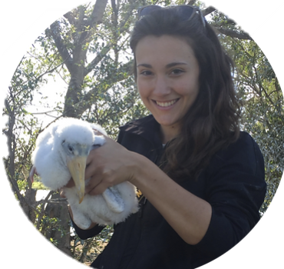
For more info:
https://ecorepsci.github.io/reproducible-science/
https://www.picardiecology.com/teaching

Slide 9

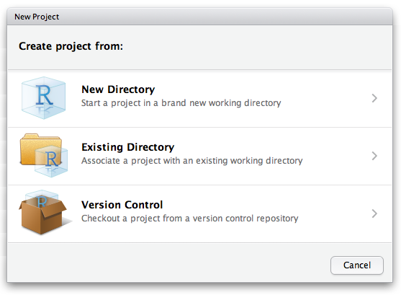
Rprojects (.Rproj)
Working within the project directory
Self-contained
Inputs, outputs, and code are all in one place
Project director is the working directory
Relative paths

Slide 10

Why use GitHub

Slide 11




Why use GitHub
Backup of your project
Keep track of changes
Network
Share research Collaborate with others

Slide 12
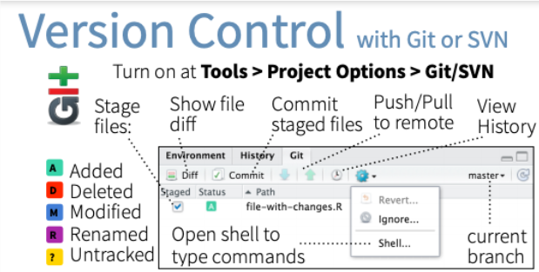
Rstudio + GitHub

Slide 13
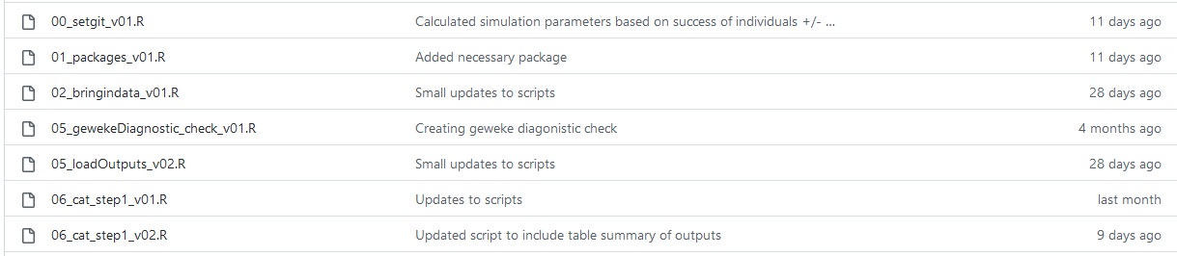
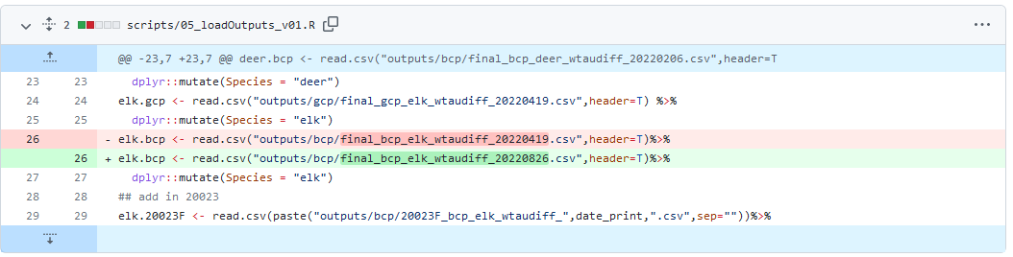
Rstudio + GitHub
Track what updates are happening
Find previous version

Slide 14





Let’s get started!
Create SSH Key
Connect SSH Key to GitHub account
Create a repository in Github
Create an Rproject and connect it to the GitHub Repository
Commit/ Push/ Pull

